Slide 1
Slack Stealing
Muhammad Amirul Hakimi bin Zaprunnizam

Slide 2
What is Slack Stealing?
An algorithm to handle aperiodic service
Contains a task name ‘Slack Stealer’
Slack means the time unit that is not contain any task or idle.
The stealer will steal all processing time from periodic task to try to provide time for aperiodic service

Slide 3
Why use Slack Stealing?
It schedule and handle aperiodic task as soon as possible.
To maintain long term reliability of the desired program.
To guarantee the schedulability of all critical tasks in worst-case conditions

Slide 4
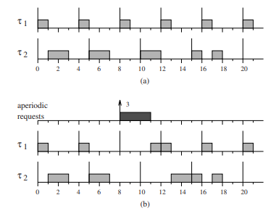
Model of Slack Stealing
Periodic task | Periods / T | Execution Time/ C
τ1 | 4 | 1
τ2 | 5 | 2
Figure (a) shows how periodic scheduling schedule when there is no aperiodic request.
Figure (b) shows an aperiodic request of three units arrives at time t = 8

Slide 5
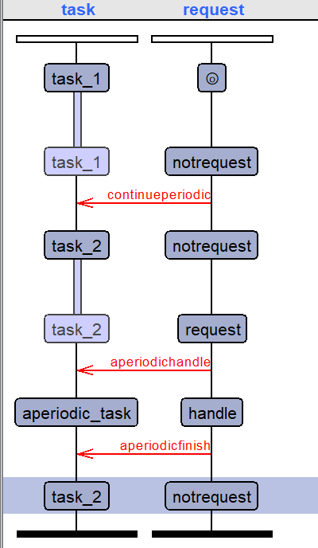
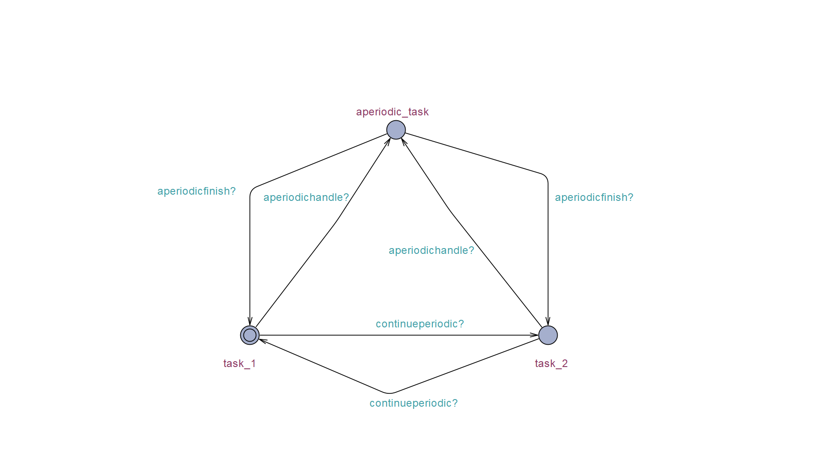
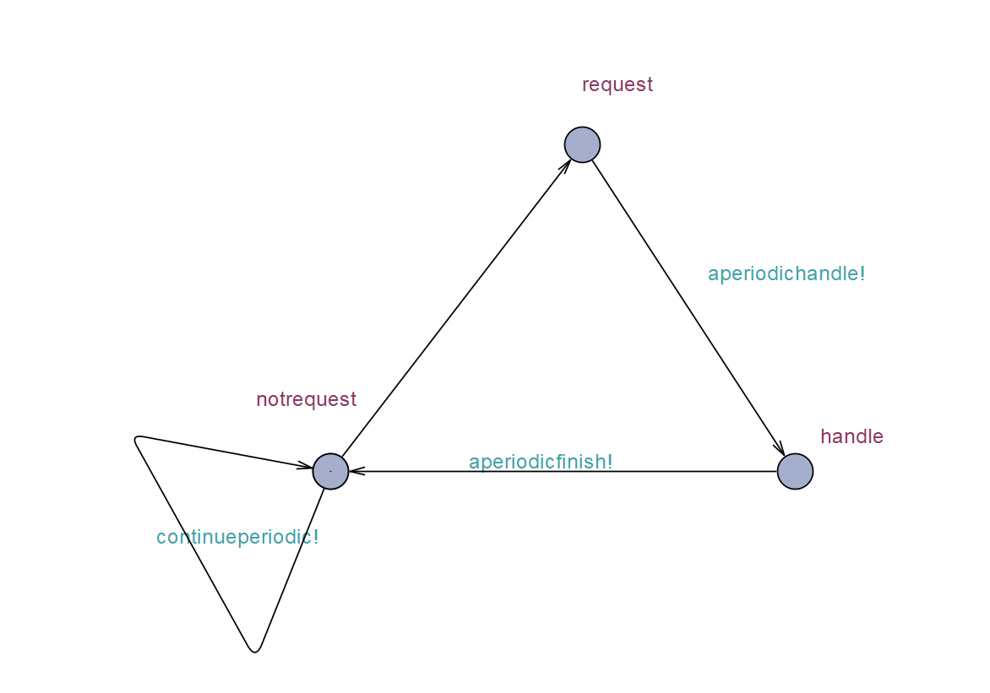
Simulation in UPPAAL
Scheduling Task
Request Task
Simulation

Slide 6
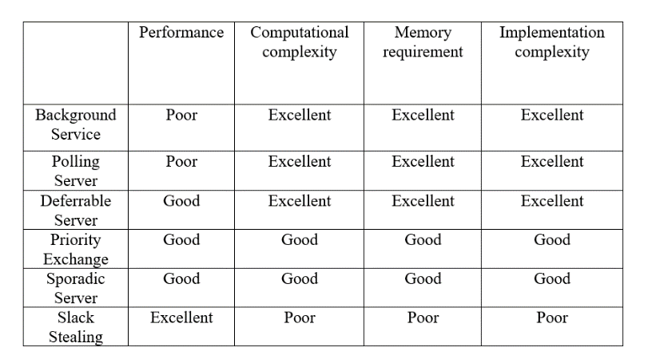
Performance

Slide 7
Reference
Thuel and Lehoczky, ”Algorithms for scheduling hard aperiodic tasks in fixed-priority systems using slack stealing,” 1994 Proceedings Real-Time Systems Symposium, 1994, pp. 22-33, doi: 10.1109/REAL.1994.342733.
Real-Time-Systems/Slack Stealing Uppaal.xml at main · VillaKimi/Real-Time-Systems (github.com)
Real-Time-Systems/Slack Stealing Documentation.pdf at main · VillaKimi/Real-Time-Systems (github.com)

Slide 8
Thank You

